Slide 1
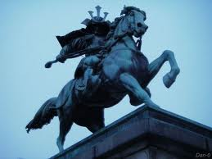
Kamakura Shogunate
The Political, Economic, And Religious Views Of The Kamakura Shogunate Civilization. Also Includes Their Social, Intellectual, And Artistic Habits.

Slide 2
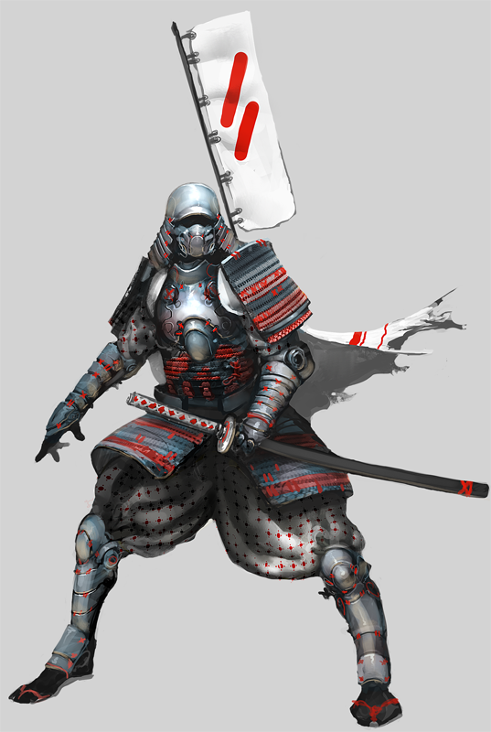
政治
Politics

Slide 3
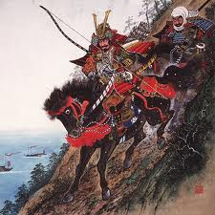
Japanese, Kamakura, Bakufu 鎌倉幕府
Was A Feudal samurai government from 1185 (or 1192, when it was formally recognized) to 1333.
Established by Yoritomo Mina Moto in 1192 A.D.
Emperors & peerage was the main political power, shogunate held real power but never truly seized it.
Hojo represented the shogunate power. He had a very powerfull family, called the Hojo Regency.
They Had NO formal laws.

Slide 4
経済
Economics

Slide 5

Self-Sufficient
People relied on each other inside there own communities.
Hardly traded with other civilizations.
Could provide everything they needed within their area.

Slide 6

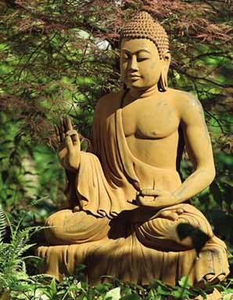
宗教 Religion

Slide 7
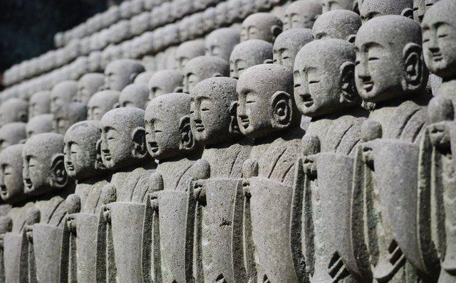
Buddhism
Pure Land
Zen
Nichiven Derived

Slide 8
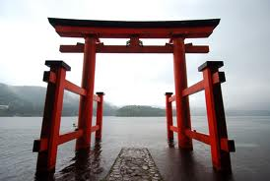
社会
Social

Slide 9
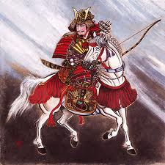
Shogunate Hierarchy
Shogun
Shogunate
Peasants
Merchants
Samurai
Artisans
Daimyo

Slide 10

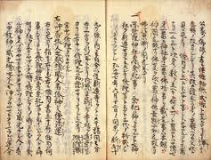
知的
Intellectual

Slide 11

Arts
Encouraged Arts Such As…
Literature
Zen
Fighting

Slide 12

芸術
Artistic

Slide 13
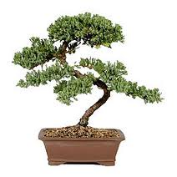
Artistic Abilities
Zen
Art
Fighting
Didn’t have many recreational activities

